Slide 1
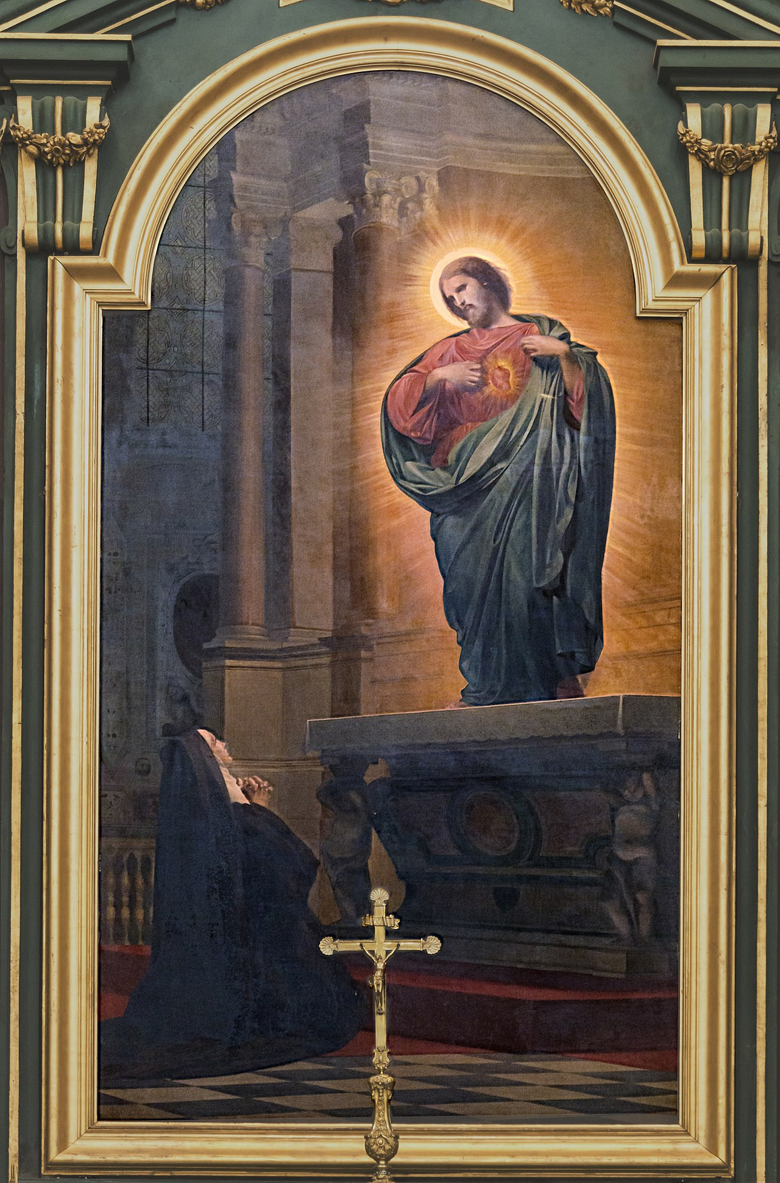
Conscience: God’s Gift to Human Beings
By Claude R. Sasso, Ph.D.

Slide 2
Opening Prayer

Slide 3
“Conduct yourselves in a way worthy of the Gospel of Christ” (Philippians 1: 27)
Life is a test of whether we shall choose the way that leads to life or the way that leads to perdition.
He has given us the gift of Conscience!
Cardinal Newman calls it “the aboriginal vicar of Christ”.
Before Jesus founded the Church on the Rock of Peter, the Vicar of Christ, early man had his conscience to guide him.
Notes:
St. Paul says, “Conduct yourselves in a way worthy of the Gospel of Christ” (Phil. 1:27). This is part of our call as Catholic Christians. Life is many things, but above all it is a test of whether we will choose the way that leads to life or the way that leads to perdition. Do we take the high road which leads to heaven and Jesus or do we follow the low road to hell and Satan? Of course, we want to choose the road to heaven. One of God’s gift to us in this journey of life choices is our conscience.

Slide 4
Conscience in the Catechism
“Moral conscience, present at the heart of a person, enjoins him at the appropriate moment to do good and avoid evil.”
“It also judges particular choices, approving those that are good and denouncing those that are evil. It bears witness to the authority of truth in reference to the supreme Good to which the human person is drawn, and it welcomes the commandments.”
“When he listens to his conscience the prudent man can hear God speaking” (CCC 1777).
Notes:
The Catechism of the Catholic Church teaches us that:

Slide 5
The Splendor of Truth by St. John Paul II
“Man has in his heart a law written by God” (Veritatis Splendor, 54).
This is the Natural Law, which allows man to discern with his reason that stealing, murder, assault, etc. are wrong.
“The universality of the law and its obligation are acknowledged; not suppressed, once reason has established the law’s application in concrete present circumstances.”
Conscience formulates moral obligation in the form of the natural law.
Notes:
As St. John Paul II reminds, us in his encyclical letter Veritats Splendor, “ or the Splendor of Truth, man has in his heart a law written by God.” This is Natural Law, which allows man to discern with his reason that stealing, murder, assault, etc. are wrong. It seems society today prefers a kind of situational ethics whereby they make up the laws to suit their behavior instead of conforming their behavior to God's Natural Law. He writes, “the universality of the law and its obligation are acknowledged; not suppressed, once reason has established the law’s application in concreted present circumstances.” Conscience formulates moral obligation in the form of the Natural Law.

Slide 6
The Judgment of Conscience
Thus, the judgment of conscience bears witness “to the authority of the natural law.”
Man can also understand the authority of God’s revealed laws given to us by Christ and through divine revelation.
If man, despite his conscience, chooses evil, the judgment of his conscience remains a witness to “the universal truth of the good.”
Notes:
A nagging conscience convicting us of an evil or bad choice is a gift.

Slide 7
Conscience is a Personal Sanctuary
Where God speaks to man.
An inner voice speaking to every man or woman.
The Holy Spirit breathing and guiding us to the Father.
“Living water within me bids me to come to the Father” (St. Ignatius of Antioch).
Notes:
Conscience is more than a little voice inside of us that assists us in making moral choice. It is a personal sanctuary where God speaks to man. At the supernatural level we see conscience as an inner voice speaking to every man and woman. It is the Holy Spirit breathing and guiding us to the Father or as St. Ignatius of Antioch expressed it, “Living water within me bids me come to the Father.”

Slide 8
The Holy Spirit
Another Advocate!
He speaks to our heart.
“Do not be conformed to this world, but be transformed by the renewal of your mind, that you may prove what is the will of God, what is good and acceptable and perfect” (Romans 12: 2).
Notes:
The Holy Spirit was sent by the Father and the Son as another Advocate and He speaks to our heart. As St. Paul urged in his letter to the Romans, Do not be conformed to this world, but be transformed by the renewal of your mind, that you may prove what is the will of God, what is good and acceptable and perfect.”

Slide 9
St. Patrick Moved by the Holy Spirit
Moved by the Spirit in a dream he heard the words, “Your ship is ready.”
Years later in Britain, he heard a voice beckoning him to return to Ireland.
Went to Europe to study for the priesthood.
Notes:
For St. Patrick, this inner voice caused him to find God in prayer and fasting while still enslaved in Ireland, to boldly escape to the coast about 200 miles distant (Killala Bay) thanks to dream in which the Spirit spoke to the young man. He knew not the way or how he would manage it, but he trusted God. Some years later back at home in Britain, he heard an Irish voice in his dream beckoning him to return to Ireland and convert the people. So he made the difficult decision to leave his home and family for Europe, where he could study to become a priest-missionary.

Slide 10
St. Patrick Listens to the Spirit speaking to his Heart
Studied under St. Martin and St. Germanus.
Eighteen years later, ordained a bishop, he set out for Ireland.
His conscience served him well as he went on to become the principal agent in the conversion of Ireland.
Notes:
So he went to Gaul/France to study to become a priest, studying under St. Martin of Tours and St. Germanus. Eighteen years later, ordained a bishop and given the name “Patritius,” by Pope Celestine I, he set out for Ireland. He spent the rest of his life listening to the voice of God in his heart, in the process saving many thousands of souls all over Ireland. In this respect he was like St. Joseph, who listened to the voice of God speaking to him in dreams. Patrick's conscience served him well and God allowed him to become the principal agent for the conversion of a pagan people, many of whom would become Saints. It took more than three leafed clovers to convince the Irish lords and kings, but God provided many miracles at the hands of his faith-filled servant.

Slide 11
Cain Goes Against His Conscience
Cain makes the wrong choice motivated by hatred and jealousy of Able.
“Why are you angry and why has your countenance fallen? If you do well, will you not be accepted? And if you do not do well, sin is couching at the door; its desire is for you, but you must master it” (Gen. 4:6-7).
After killing his brother, he is forced to lead a fugitive lifestyle.
Notes:
On the other hand, Cain made the wrong choice when he chose to kill his brother Able, out of hatred and jealousy. Crestfallen at the fact that Abel’s offering to God was accepted because it came from the heart, and his offering was not, he was angry. The Lord said to Cain, ”Why are you angry . . .” Obviously, Cain rejected his conscience and let sin become his master. As a result, he was forced to live a fugitive lifestyle. We ae all given choices in our lives, but in order to make them rightly, so they lead to union with God, we need a formed or informed conscience.

Slide 12
Forming our Conscience
Following our conscience is not enough if it is not formed properly.
“The education of conscience is indispensable for human beings who are subjected to negative influences and tempted by sin to prefer their own judgment and to reject authoritative teachings” (CCC 1783).
“The education of conscience guarantees freedom and engenders peace of heart” and “is a lifelong task” (CCC 1784).
Notes:
Following our conscience is not enough if it is not formed properly. Although conscience is an natural gift given to all of us, it may not serve you well in all instances, including important choices of life and death, unless it is well formed. The Catechism teaches, “The education of conscience is indispensable for human beings who are subjected to negative influences and tempted by sin to prefer their own judgment and to reject authoritative teachings.” It adds, “The education of conscience guarantees freedom and engenders peace of heart” and this is a “lifelong task.”

Slide 13
Voting is a Moral Act
Requiring a well-formed conscience.
, “Our conscience does not determine what is right or wrong--God does! Our conscience tells us whether our actions consistent with what his Law teaches is right or wrong. Therefore, forming our conscience is critically important not just for voting, but for our sanctification and salvation” (Bishop James V. Johnston, Jr.)
Notes:
Bishops serve as the chief catechist in every diocese with the obligation to catechize the faithful. In a recent letter to all Catholics in the diocese of Kansas City-St. Joseph, the Bishop reminded Catholic voters that voting is “a moral act requiring a well-formed conscience.” He wrote, “Our conscience does not determine what is right or wrong—God does! Our conscience tells us whether our actions are consistent with what his Law teaches is right or wrong. Therefore, forming our conscience is critically important not just for voting, but for our sanctification and salvation.”

Slide 14
St. Pope John Paul II
“Because of the nature of conscience, the admonition always to follow it must immediately be followed by the question of whether what our conscience is telling us is true or not. If we fail to make this necessary clarification, conscience--instead of being that holy place where God reveals to us our true good--becomes a force which is destructive of our true humanity and of all our relationships (General Audience, August 17, 1983).
Notes:
He then quoted St. John Paul II, who said:

Slide 15
Jesus on a Deformed Conscience
“The eye is the lamp of the body. So if your eye is sound your whole body will be full of light; but if your eye is not sound, your whole body will be full of darkness. If then the light in you is darkness, how great is the darkness!” (Matthew 6: 22-23).
Notes:
Jesus himself address the danger of a deformed conscience, when he warns:

Slide 16
Some Commonly Held Misconceptions
Abortion “is gravely contrary to moral law.”
Rights of the child?
Conceived child has a separate body and an eternal soul made in the image and likeness of God.
“Abortion denies our inherent God-given dignity as human beings, and it brings violence and death into the family.”
Notes:
Let’s take the case of a procured abortion. Abortion deprives a child conceived in the womb of its mother the gift of life and in the words of the Catechism ”is gravely contrary to moral law.” Yet many people, even Catholic Christians, have come to the conclusion, that it is permissible or worse, that it is the right of the woman, thus failing to appreciate the rights of the conceived child who has a separate body and an eternal soul. As Michael Warsaw put it in a recent editorial in the National Catholic Register, “Abortion denies our inherent God-give dignity as human beings, and it brings violence and death into the family.” It makes parents complicit in the death of their own children.

Slide 17
Misconception: Homosexual Acts are Good
Sacred Scripture is clear: they are acts of grave depravity. Love the sinner, hate the sin.
“intrinsically disordered” and contrary to natural law, because “they do not proceed from a genuine affective and sexual complementarity” (CCC 2357).
“sexuality is ordered to the conjugal love of man and woman” (CCC 2360).
Notes:
Another example would be the common conception among some young people who earnestly want to compensate for the mistreatment of homosexuals in the past, by concluding that homosexual acts must be morally good. The Word of God, contained in Sacred Scripture, sees homosexual acts of acts of grave depravity and the Catechism labels them, “intrinsically disordered” and contrary to Natural Law, because ”they do not proceed from a genuine affective and sexual complementarity. As Cardinal Burke said recently, the Church teaches us to hate the sin but to love the sinner. Other examples could be given, but from these examples we see that conscience is not well served if it is not informed.

Slide 18
Forming One’s Conscience
Sacred Scripture is a “light unto our path” in life, to be read, studied and lived. St. Paul calls it “the helmet of salvation and the sword of the Spirit” (Ephesians 6:17).
One of the virtues it teaches is humility.
“Humble yourselves before the Lord and He will exalt you” (James 4:10).
Humility is the base plate for sainthood and is necessary to overcome pride.
It is the foundation of all other virtues.
Notes:
Every Christian should make the effort to read the Sacred Scriptures because the Word of God is an important tool (“a light unto our path”) in conscience formation when read, studied and put into practice. It is literally the cutting edge for saintly formation. One of the virtues it teaches is humility. Humility is the base plate of sainthood because it is the foundation of all other virtues and is necessary to overcome pride. Scripture says, “Humble yourselves before the Lord and He will exalt you.” There is no respect for others without humility in ourselves.

Slide 19
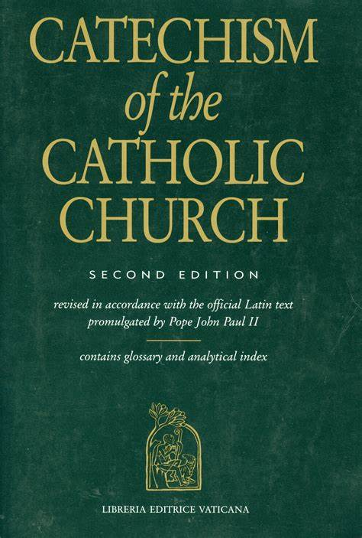
Conscience Formation
Reading/learning the Catechism is essential because it informs our conscience of magisterial teaching and gives us an understanding of salvation history. It even teaches us how to pray.
Gifts of the Holy Spirit are most evident in the penitent who examines his/her conscience and receives the graces given in the Sacrament of Confession.
Seek the moral guidance of the Church
Notes:
The authoritative teaching of the Church, especially as found in the beautifully written treasure we call the CCC, is also essential to this formation. It includes both arms of the Deposit of Faith, namely, Apostolic Tradition and Sacred Scripture. It informs us of magisterial teaching and narrates salvation history. It even teaches us how to pray. Regular Confession is also key. The gifts of the Holy Spirit are most evident in the penitent who regularly examines his or her conscience and receives the graces given in the Sacrament. Seek the moral guidance of the Church Jesus gave us as the instrument for the salvation of all men, who will be saved.

Slide 20
Forming One’s Conscience
The process of forming one’s conscience is brought to fruition in prayer and study.
Finding a spiritual adviser is helpful.
All of this along with frequent reception of the Sacraments, should lead to the cultivation of virtues.
St. John Paul II says we also need a kind of connaturality between man and the true good, which comes from being rooted in virtuous attitudes, the cardinal virtues such as prudence, and the theological virtues of faith hope and charity.
The Education of Conscience is a lifelong challenge formed with the help of:
Sacred Scripture
The Catechism of the Catholic Church
Frequent reception of the Sacraments
Personal and Ecclesial prayer & study
Notes:
The process of forming one’s conscience is brought to fruition in prayer, both personal and ecclesial, and study to develop a morally sensitive conscience. It is also helpful where possible to find a spiritual adviser. All of this along with frequent reception of the Sacraments, should lead to the cultivation of virtues. This is a lifelong challenge, but one that will save us a lot of heartache. St. John Paul II agrees, noting that we need a kind of connaturality between man and the true good, which comes from being rooted in virtuous attitudes, the cardinal virtues such as prudence and the theological virtues of faith, hope and charity. This is the meaning of Jesus’ saying: “He who does what is true, comes to the light” (John 3:21).

Slide 21
Enlightened Moral Judgment
“We must examine our conscience before the Lord’s Cross” (CCC 1785). The shadow of the Cross falls upon our sins.
Distinguishes our subjective self from what is objectively true outside of ourself.
When our conscience is certain, we must follow it.
In the case of a doubtful conscience, we should seek clarification from a confessor or spiritual adviser.
Notes:
If conscience is properly formed in humility to the Church’s teaching our moral judgments will be enlightened. The Catechism says, “We must examine our conscience before the Lord’s Cross. The shadow of the Cross falls upon our sins. We are always required to distinguish our subjective self from what is objectively true outside of ourself. As the CCC teaches, when our conscience is certain, we must follow it. On the other hand, we should not follow a doubtful conscience, but rather seek clarification from our confessor or spiritual adviser.

Slide 22
Ignorance Does Not Exonerate us from Evil Action
Take the time to find out what is true and good.
Habitual sin can almost blind one’s conscience.
The Catechism provides clear moral guidance:
“Ignorance of Christ and his Gospel, bad example given by others, enslavement to one’s passions, assertion of a mistaken notion of autonomy of conscience, rejection of the Church’s authority and her teaching, lack of conversion or of charity these can be the source of errors of judgment in moral conduct” (CCC 1792).
Notes:
Even ignorance does not exonerate us from an evil action, if we do not take the time to “find out what is true and good.” Habitual sin can almost blind one’s conscience, but does not excuse our culpability. The Catechism says:

Slide 23
Saints
The Saints were scrupulous to avoid the near occasion of sin and practice moral virtue.
Especially charity and self-sacrifice.
Some suffered from scrupulosity.
Notes:
Even a cursory study of the Saints leads to the conclusion that they were scrupulous to avoid the near occasion of sin and practice moral virtue. They sought moral integrity in every part of their lives, especially as regards charity and sacrificial acts. They wanted to love Jesus more perfectly, but were often only too aware of their own sins. Thus, some were prone to exaggerate their sins and hence suffered from scrupulosity.

Slide 24
Scrupulosity
Involves falling prey to thoughts that force us to exaggerate our own sins, see mortal sins where there are only venal sins, and failing to distinguish sinful thoughts that pop into our mind, but which we do not entertain by consciously dwelling upon them.
Jesus taught that lust, dwelling upon impure thoughts about another person, is equivalent to adultery.
But there is a difference between a passing thought we put out of our mind and one we choose to dwell upon to derive pleasure, knowing it is gravely wrong.
Avoid the near occasion of sin, but remember that we cannot prevent sinful thoughts from sometimes presenting themselves to our mind. Banish them with a short prayer and avoid situations that tempt us to sin.
Notes:
Some fell into scrupulosity, which involves falling prey to thoughts that force us to exaggerate our own sins, to see moral sins, where there are only venal sins, and failing to distinguish sinful thoughts that pop into our mind, but which we do not entertain by consciously dwelling upon them. Jesus taught that lust, entertaining impure thoughts about another person, is equivalent to adultery. But there is a difference between a passing thought we put out of our mind and one we choose to dwell upon to derive pleasure, knowing it is gravely wrong. We can and should make every effort to avoid the near occasion of sin, but we cannot prevent sinful thoughts from sometimes presenting themselves to our mind. Our focus should be to banish these thoughts when they occur with a short prayer seeking help from God.

Slide 25
Saints who suffered from Scrupulosity
St. Ignatius of Loyola believed that impure or aggressive thoughts that came to his mind were grave sins and resolved not to eat or drink until he found peace, but his confessor helped him overcome this.
St. Maximilian Kolbe likewise suffered from worries concerning God’s mercy, but overcame them with the help of his spiritual adviser, Fr. Luigi Bondini .
St. Ignatius at Manresa
Notes:
Many Saints suffered from scrupulosity, including St. Ignatius of Loyola, as a young man, believing for a time when he had isolated himself at the Cavern of Manresa, Spain, that impure or aggressive thoughts that came to his mind were grave sins. He made a Confession at Santa Maria Montserrat Abbey and then went to the nearby cavern at Manresa for a week of self-imposed penance, but was plagued by his scruples. He had thoughts that he had not confessed all his sins or their circumstances and was resolved to neither eat or drink (unless his life was in danger) until he received the peace of Christ. But his austerities were ended by a confessor, who counseled him in the confessional to avoid being consumed by his scruples. Kolbe counseled to place his faith in the Immaculate Virgin Mary and in the mercy of God.

Slide 26
Luther Suffered from Scrupulosity
Confessed his sins and performed his penances religiously, but…
In spite of it all, my conscience was always in a fever of doubt. The more I sought to help my poor stricken conscience the worse it got. The more I paid attention to the regulations the more I transgressed them…”
Realized that faith played a role in overcoming his scruples, but sought relief for his guilt by denying the efficacy of Confession, penance and indulgences, claiming that faith alone was sufficient.
Unlike St. Ignatius or St. Maximilian, Luther did not listen to the Church, but went his own way, causing great damage both to himself and to the Church in the process.
Notes:
An Augustinian monk named Martin Luther also suffered from scrupulosity. In his Epistle to the Galatians commentary he wrote:
“When I was a monk I tried ever so hard to live up to the strict rules of my order. I used to make a list of my sins, and I was always on the way to confession, and whatever penances were enjoined upon me I performed religiously. In spite of it all my conscience was always in a fever of doubt. The more I sought to help my poor stricken conscience the worse it got. The more I paid attention to the regulations the more transgressed them. . . “ Someone has written that Luther was “first and foremost a man at war with himself. His writings are overflowing with examples of his inner struggles with sin and grace. He clearly suffered from the spiritual malady of scrupulosity. He realized ...

Slide 27
Illumination of Conscience
Some have been fortunate enough to have experienced an illumination of conscience, which can turn a sinner’s heart to God.
One such person, was C. Alan Ames, a Catholic mystic and former violent alcoholic, who described an illumination he experienced in 1994:
“It was the greatest day of my life, but also the most difficult because I was shown how all my sins, from childhood to the present, contributed to His [Jesus’] suffering and dying. There were so many of them!

Slide 28
Testimony of C. Alan Ames, Catholic Mystic
“It seemed as though I was sinning every second of my life. I saw how every time I hurt someone, I was hurting Jesus. Any time I told a lie, I was lying about Jesus as He suffered and died. Every time I gossiped about people, I was below the Cross with those gossiping about Jesus as He hung in agony. Any time I made fun of others, I was making fun of Jesus as He died for me. Even the smallest sin, even the thoughts I had toward others—of dislike, anger, hate or frustration—seemed so big. And to see my grievous sins was absolutely terrible” (Watkins, The Warning, p.62).

Slide 29
Ames’ Testimony Continued
“Jesus showed me the state of my soul, which was putrid. He revealed how my sins not only hurt other people but often led them into sin, such as when they tried to imitate me or responded with anger or violence. I felt so ashamed, so unworthy and offensive. I wanted to run away, but couldn’t and Jesus wouldn’t leave me. Worse yet, He kept telling me He loved me and longed to forgive me” (Watkins, p. 62).

Slide 30
Illumination Producing Conversion
Alan then had a vision of our Lord’s terrible suffering in the Garden of Gethsemane and on the Cross, and he begged Jesus to let him die, and be condemned to hell.
He broke down and cried for hours, but with God’s grace eventually asked for forgiveness and transformed his life.
Notes:
Ames wrote, “I fell in love with Jesus that day and I totally committed my life to God.” Today he has an international ministry and has produced books, like his trilogy, Through the Eyes of Jesus, which is basically private revelation of stories Jesus shared with him about his three year ministry with the Apostles.

Slide 31
What Should We Do?
God is calling you today to reform your life and your conscience.
Draw near to Him in the Sacraments of the Church.
Form and Inform your Conscience. Listen to it.
Steep yourself in his Word and in the magisterial teaching of the Church.
Ask God’s forgiveness for your sins and dedicate your life to serving Him in whatever vocation He has called you to.
Help others to do the same! Become a spiritual first responder for Christ.
Notes:
Whether you have a similar experience to Mr. Ames or not, God is calling you today to reform your life and conscience. He is calling you to draw near to Him in the Sacraments of the Church and to confess your sins regularly. He is calling you to form your conscience in His Word. Steep yourselves in the Word of God and the magisterial teaching of the Church. Ask God for forgiveness of your sins and dedicate your life to serving Him in whatever vocation He has called you to. Work to save souls. Conscience is a gift from God. Become a spiritual first responder for Christ. The resources of this conference can launch your efforts!

Slide 32
Prayer of St. Alphonsus Liguori before Confession
O my God, help me to make a good confession. Mary, my dearest Mother, pray to Jesus for me. Help me to examine my conscience, enable me to obtain true sorrow for my sins, and beg for me the grace rather to die than to offend God again. Lord Jesus, light of our souls, who enlightens every man coming into this world, enlighten my conscience and my heart by Thy Holy Spirit, so that I may perceive all that is displeasing to Thy divine majesty and may expiate it by humble confession, true contrition, and sincere repentance..
Notes:
From Catholic Online

